Slide 1
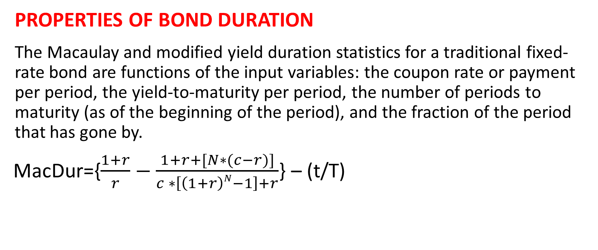
Module5 Understanding Fixed-Income Risk and Return
PROPERTIES OF BOND DURATION
The Macaulay and modified yield duration statistics for a traditional fixed-rate bond are functions of the input variables: the coupon rate or payment per period, the yield-to-maturity per period, the number of periods to maturity (as of the beginning of the period), and the fraction of the period that has gone by.
MacDur={$\frac{1+r}{r}−\frac{1+r+[N∗(c−r)]}{c ∗\left[\left(1+r\right)N−1\right]+r}$} – (t/T)

Slide 2
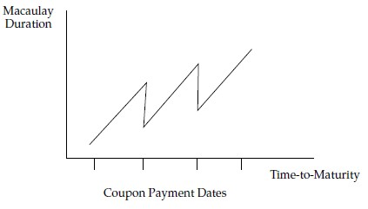
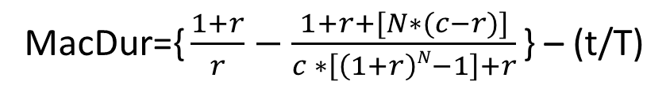
Module5 Understanding Fixed-Income Risk and Return
Macaulay duration between coupon payments with a constant YTM
MacDur={$\frac{1+r}{r}−\frac{1+r+[N∗(c−r)]}{c ∗\left[\left(1+r\right)N−1\right]+r}$} – (t/T)

Slide 3
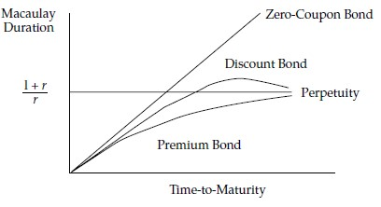
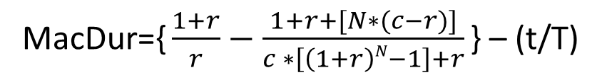
Module5 Understanding Fixed-Income Risk and Return
Properties of the Macaulay yield duration
MacDur={$\frac{1+r}{r}−\frac{1+r+[N∗(c−r)]}{c ∗\left[\left(1+r\right)N−1\right]+r}$} – (t/T)

Slide 4
Module5 Understanding Fixed-Income Risk and Return
A higher coupon rate or a higher yield-to-maturity reduces the duration measures. A longer time-to-maturity usually leads to a higher duration. It always does so for a bond priced at a premium or at par value. But if the bond is priced at a discount, a longer time-to-maturity might lead to a lower duration. This situation only occurs if the coupon rate is low (but not zero) relative to the yield and the time-to-maturity is long.

Slide 5
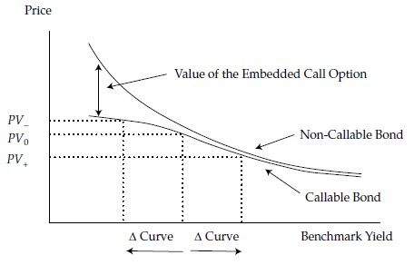
Module5 Understanding Fixed-Income Risk and Return
Interest rate risk characteristics of a callable bond
Therefore, an embedded call option reduces the effective duration of the bond, especially when interest rates are falling and the bond is more likely to be called. The lower effective duration can also be interpreted as a shorter expected life—the weighted average of time to receipt of cash flow is reduced.

Slide 6
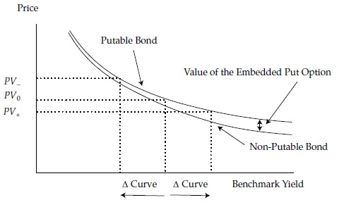
Module5 Understanding Fixed-Income Risk and Return
Interest rate risk characteristics of a putable bond
An embedded put option reduces the effective duration of the bond, especially when rates are rising. In summary, the presence of an embedded option reduces the sensitivity of the bond price to changes in the benchmark yield curve, assuming no change in credit risk.

